Slide 1
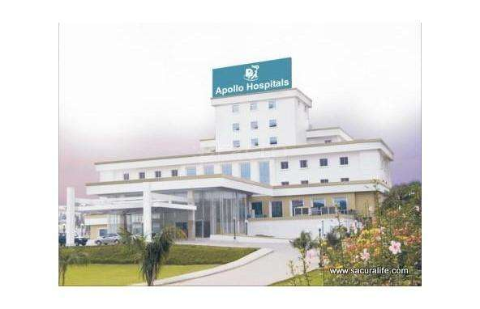
Forecasting Demand for Food at Apollo Hospitals
“To make or not to make”
Group 4

Slide 2

Apollo Hospital
A tertiary care hospital with 250 beds
Around 230 in-patients treated daily
Provision of food and beverages daily- 5 times a day
Challenge
Outcome
Reduce the cost by reducing wastage
Food and beverages constitutes 4% of the overall cost of the hospital. (Food cost= raw material, meat, veg and chicken)
20% to 60% food prepared in excess leads to high wastage
10% extra always prepared. Food consumption dilemma: Cannot tell the patients that the food is over!!

Slide 3


Slide 4

Forecasting challenge: food wastage
Assumptions
Only breakfast items. Pre, post consumption wastage and losses due to excess procurement not included.
Dietician’s plan hence the food ordered would be uniform e.g cardiac food may not have idli and puri
Key Data findings
Chutney and sambar: mean, median and mode were same, due to consumption with idli, dosa. If we can predict idli,dosa- sambar and chutney can also be predicted
Wastage: Dosa has maximum wastage followed by Idli, North Indian B/f, omelette, continental B/f and chutney and sambar.
Dependent variable: number of patients staying in Hospital.
*For detailed processing: https://rpubs.com/KumarGyanam/Apollo_Case

Slide 5

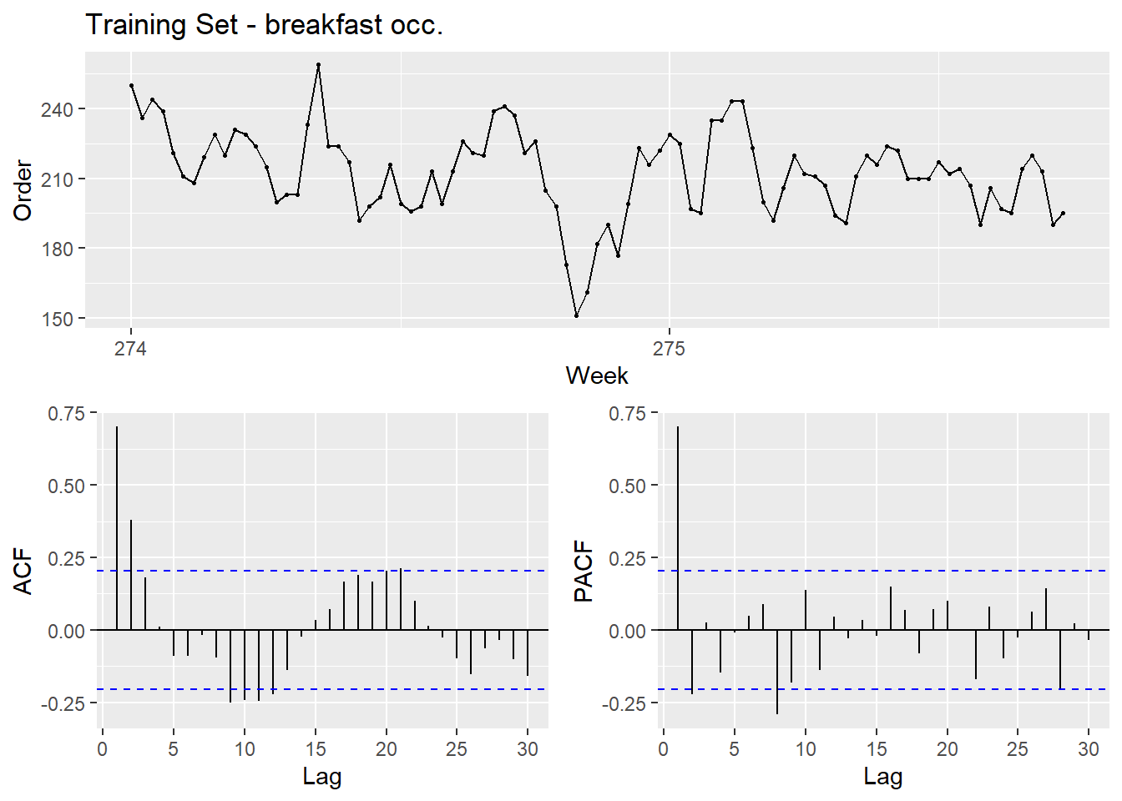
Process
Data hygiene
Linear regression: Relationship found of dosa, idli, sambar and chutney
Strong co-relation found between consumption of idli,dosa with sambar and chutney. Hence combined sambar, chutney
sambar or chutney = 0.4642 sum( idly, dosa) + 92.4376
Next, compared item to breakfast occupancy
idli = 0.04456 BKFST_OCCUP + 49.68300
dosa = -0.03707 BKFST_OCCUP + 33.45358
continental = -0.06524 BKFST_OCCUP + 55.34115
omelet = 0.04451 BKFST_OCCUP + 4.01375 (p value is very low)
North Indian = 0.01125 FST_OCCUP + 1.02629 (p less)
Forecasting using arima model. Creating training and test and plotted the ACF and PACF
More than once the ACF and PACF lines crossed the border, indicating unstable data.
*For detailed processing: https://rpubs.com/KumarGyanam/Apollo_Case

Slide 6
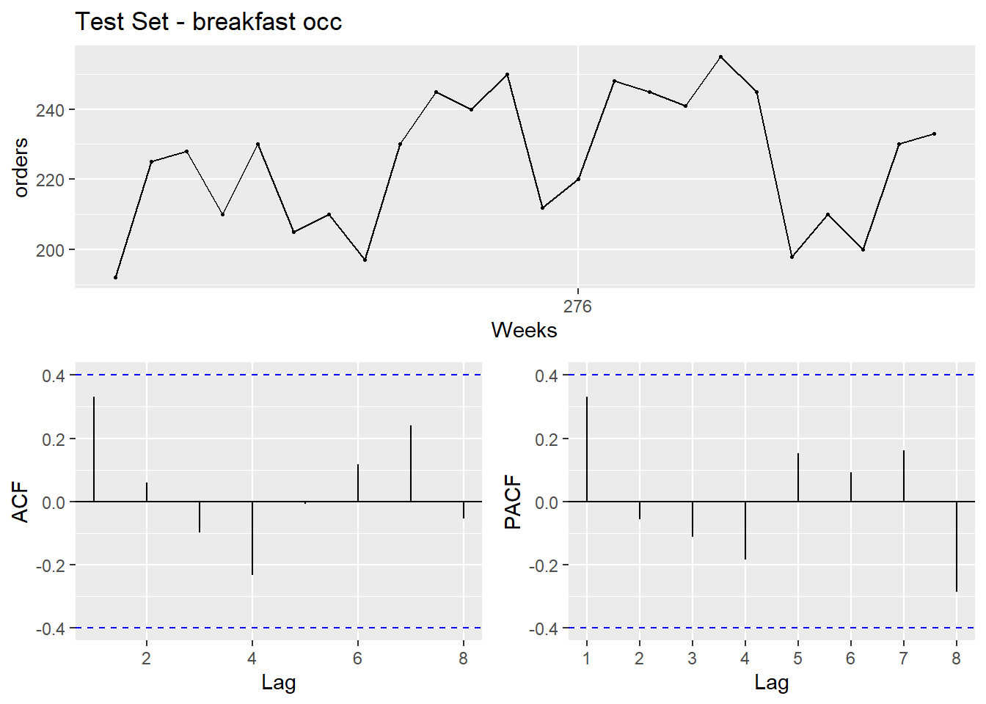
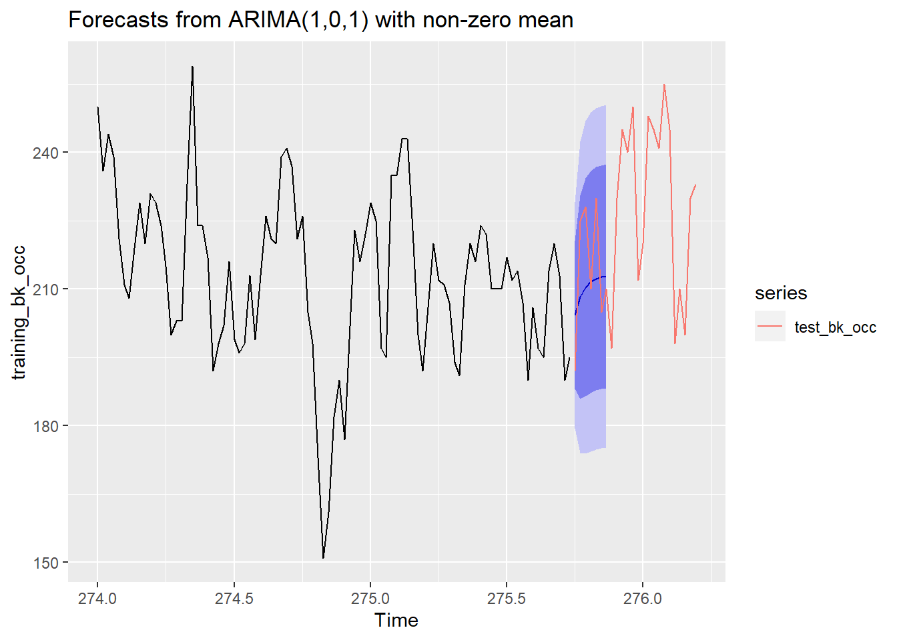
Process
To check for stability: Box- Ljung test on training set.
p-value = 0.06107 indicating insignificance
Identified the best fitting ARIMA model. p d q
1 0 1
Accuracy of the model, we will be using point forecast
*For detailed processing: https://rpubs.com/KumarGyanam/Apollo_Case

Slide 7
Model:
Day | Forecast | Lo 80 | Hi 80 | Hi 95 | Lo95
1 | 204 | 188 | 221 | 180 | 229
2 | 208 | 186 | 231 | 174 | 242
3 | 210 | 187 | 234 | 174 | 247
4 | 212 | 187 | 236 | 174 | 249
5 | 212 | 188 | 237 | 175 | 250
6 | 213 | 188 | 237 | 175 | 250
7 | 213 | 188 | 237 | 175 | 250
 | m | c
Idly | 0.04456 | 49.683
Dosa | -0.03707 | 33.45358
Chutney | 0.4642 | 92.4376
Sambar | 0.4642 | 92.4376
Continental B/F | -0.06524 | 55.34115
North Indian B/F | 0.01125 | 1.02629
Omellette | 0.04451 | 4.01375
Forecast_day | BKFST_OCCUP | Idly | Dosa | Chutney | Sambar | Continental B/F | North Indian B/F | Omellette
1 | 204 | 59 | 26 | 132 | 132 | 42 | 3 | 13
2 | 208 | 59 | 130 | 180 | 180 | 42 | 3 | 13
3 | 210 | 59 | 131 | 181 | 181 | 42 | 3 | 13
4 | 212 | 59 | 20 | 129 | 129 | 42 | 3 | 13
5 | 212 | 59 | 36 | 137 | 137 | 41 | 3 | 13
6 | 213 | 59 | 43 | 140 | 140 | 41 | 3 | 13
7 | 213 | 59 | 33 | 135 | 135 | 41 | 3 | 13
Furthermore, we suggest to use the model to predict for 7 days.
As the procurement cycle is 2 days for fresh items
Room for accommodating any changes esp in occupancy

Slide 8
Key Questions
Apollo serves 120 food items from its kitchen. Do you think that Apollo should develop forecasting models for all 120 items?
No. Food across do not have the same consumptions pattern hence the focus should be as per the demand
What inferences can be obtained from the data using descriptive analytics?
Accomplishing items like chutney and sambar have co-relation with Dosa, Idli
Dosa, Idli needs to be prioritized to reduce the wastage
Data is limited to a period of ~4 months also the collection is manual
Develop an appropriate forecasting model for each of the chosen food items.
Done
How would you figure out whether food demand (for each of the items) is related to the occupancy?
Linear regression to find out the relationship

Slide 9
Key Questions
Comment about Dr. Rao’s concerns on the maintenance and scalability of the model
Continuous remodeling as various external variable may have an impact (guidelines, external factors, pandemic, bed occupancy, location etc.)
Further study of any more variables
Data is limited and not collected well
Investment in consultancy or recruiting team (data science, ML)
Model will have to be developed for each location
Human intelligence may be required to make it fool proof

